Slide 1
Unit 1: Linear equations and functions [线性方程和函数]

Slide 2

Advance organizer
Learning objectives:
Understand 1.1 Patterns and Expressions
Understand 1.2 Properties of Real Numbers
Prior knowledge:
N/A
Successful criteria:
Controlled Practice: Complete the Exit Card
Freer Practice: Complete questions to your interest
Learning activities:
1. Preview and Vocabulary Check (10 minutes):
Quickly scan through the text and noting any unfamiliar terms.
2. Comprehend the Presentation (45 minutes):
3. Exit Card Completion (25 minutes):
4. Main Idea Summary and Reflection (5 minute):

Slide 3
Key terms
Constant[常数]: A constant is a fixed value or number that does not change in a given context or equation.
Variable quantity[变量数量]: A variable quantity refers to a value that can change or vary in a particular situation or equation.
Variable[变量]: A variable is a symbol or letter used to represent an unknown or changing value in mathematics and equations.
Numerical expression[数值表达式]: A numerical expression is a combination of numbers and mathematical operations (such as addition, subtraction, multiplication, and division) that results in a single numerical value.
Algebraic expression[代数表达式]: An algebraic expression is a combination of variables, constants, and mathematical operations.

Slide 4
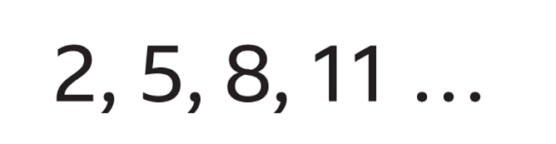
Number pattern
A number pattern which increases (or decreases) by the same amount each time is called a linear sequence.

Slide 5
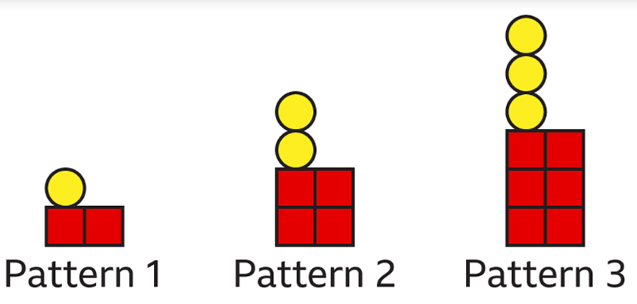
Pattern in shapes

Slide 6
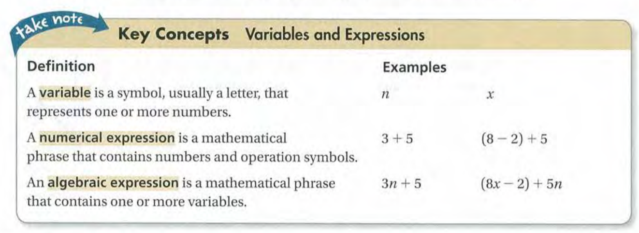

Slide 7
Algebraic expressions
Complete the guided algebraic expression learning sheet

Slide 8
1.2 Key terms
Opposite[相反]: Opposite refers to something that is contrary or diametrically different in nature, direction, or characteristics from another thing.
Additive inverse[加法逆元]: The additive inverse of a number is the value that, when added to the original number, yields a sum of zero.
Reciprocal[倒数]: The reciprocal of a number 'a' is defined as 1 divided by 'a'. In other words, if 'a' is a nonzero number, its reciprocal is 1/a.
Multiplicative inverse[乘法逆元]: The multiplicative inverse (or reciprocal) of a number 'a' is the value that, when multiplied by the original number, gives a product of 1.
Number line[数轴]: A number line is a visual representation of real numbers.

Slide 9
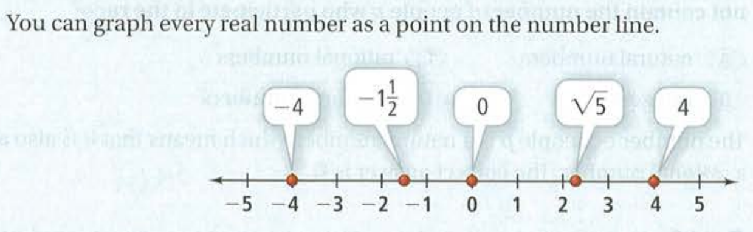
Number line

Slide 10
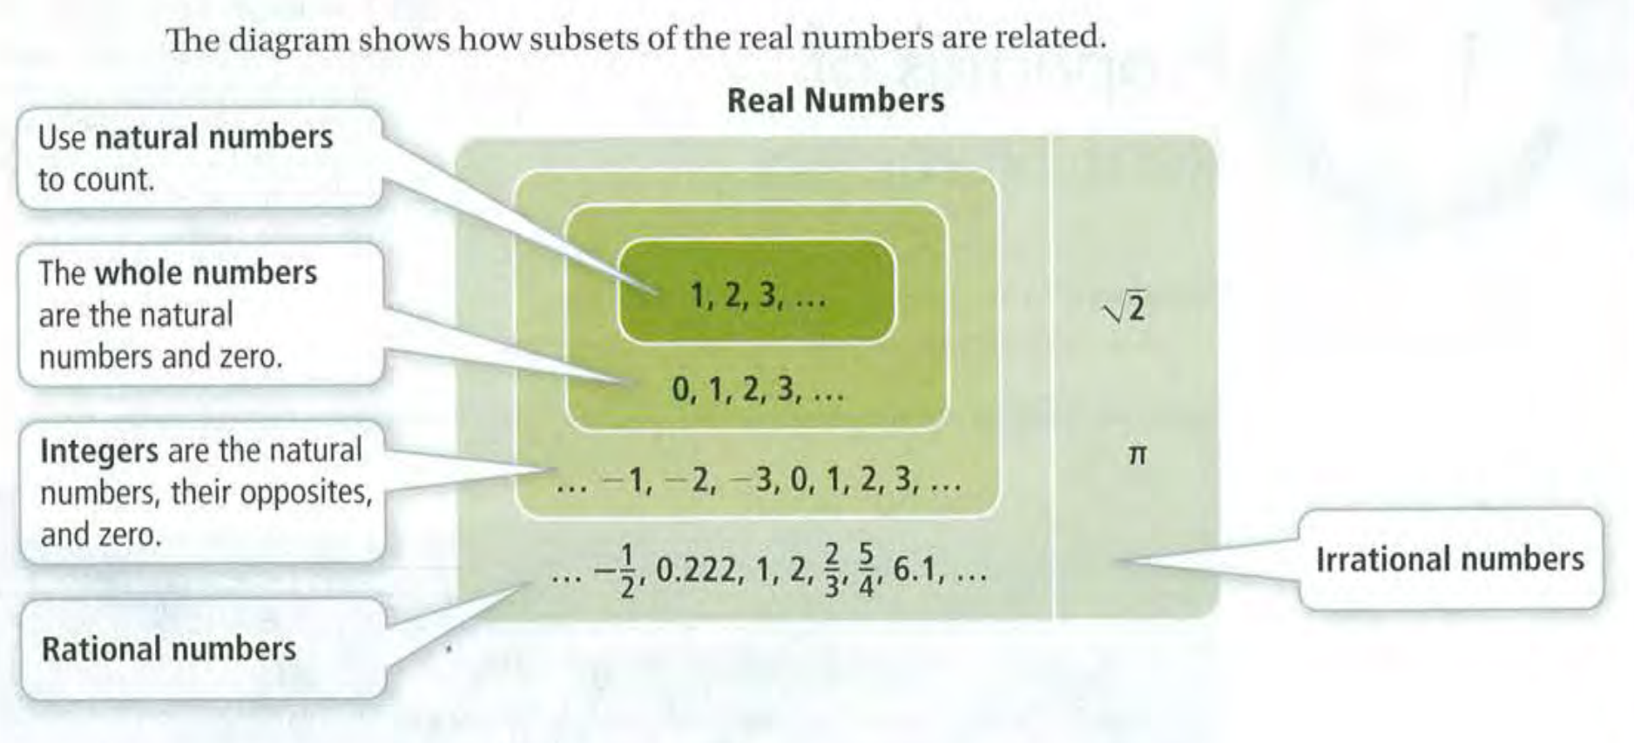
Real Numbers
Real Number - 实数
Natural Number - 自然数
Whole Number - 整数
Rational Number - 有理数
Irrational Number - 无理数

Slide 11
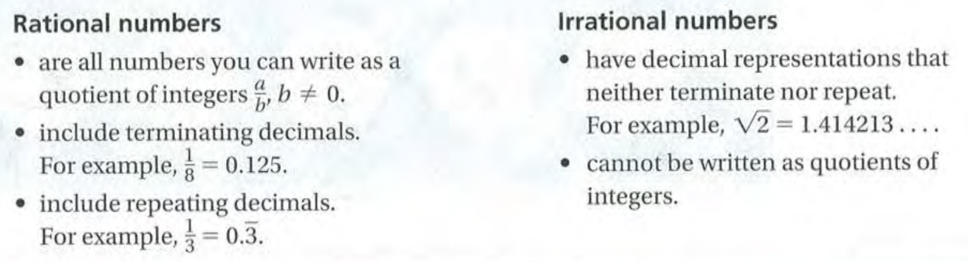
Rational numbers vs. Irrational numbers

Slide 12
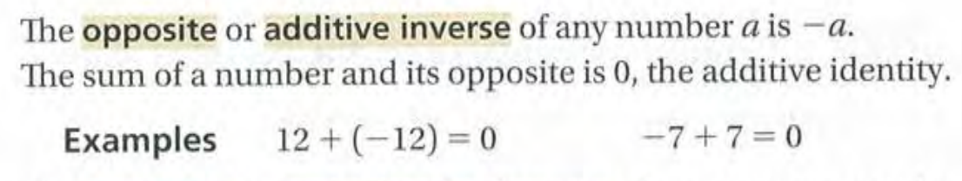
Opposite or additive inverse

Slide 13
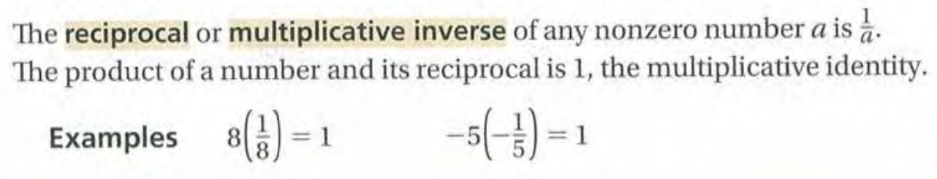
Reciprocal or multiplicative inverse

Slide 14
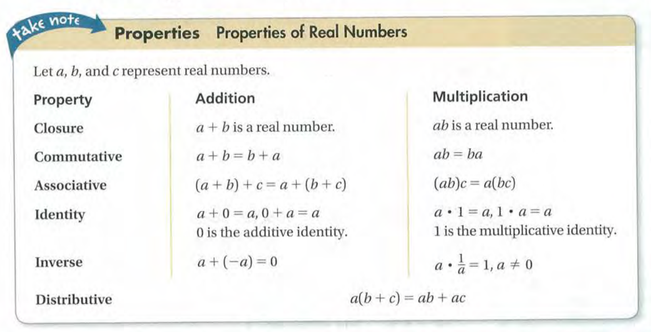
Property - 性质
Closure - 封闭性
Commutative - 交换律
Associative - 结合律
Identity - 单位元
Inverse - 逆元
Distributive - 分配律

Slide 15
Properties of Real Numbers
Complete the properties of real number learning sheet!

Slide 16
Exit card:
Complete both learning sheets before you leave the classroom!

Slide 17
Advance organizer
Learning objectives:
Understand 1.3 Algebraic Expressions
Understand 1.4 Solving Equations
Prior knowledge:
Understand 1.1 Patterns and Expressions
Understand 1.2 Properties of Real Numbers
Successful criteria:
Controlled Practice: Complete the Exit Card
Freer Practice: Complete questions to your interest
Learning activities:
1. Preview and Vocabulary Check (10 minutes):
Quickly scan through the text and noting any unfamiliar terms.
2. Comprehend the Presentation (45 minutes):
3. Exit Card Completion (25 minutes):
4. Main Idea Summary and Reflection (5 minute):

Slide 18
Key terms
Evaluate (评估): To determine the value or result of an expression or equation.
Term (项): A single mathematical expression or component in an algebraic expression or equation.
Coefficient (系数): A numerical factor that multiplies a variable in an algebraic expression or equation.
Like Term (同类项): Terms in an algebraic expression that have the same variables raised to the same powers, making them suitable for combination or simplification.
Equation (方程): A mathematical statement that asserts the equality of two expressions, typically separated by an equal sign (=).
Literal Equation (文字方程): An equation containing one or more variables, often used to represent relationships in various mathematical and scientific contexts.

Slide 19
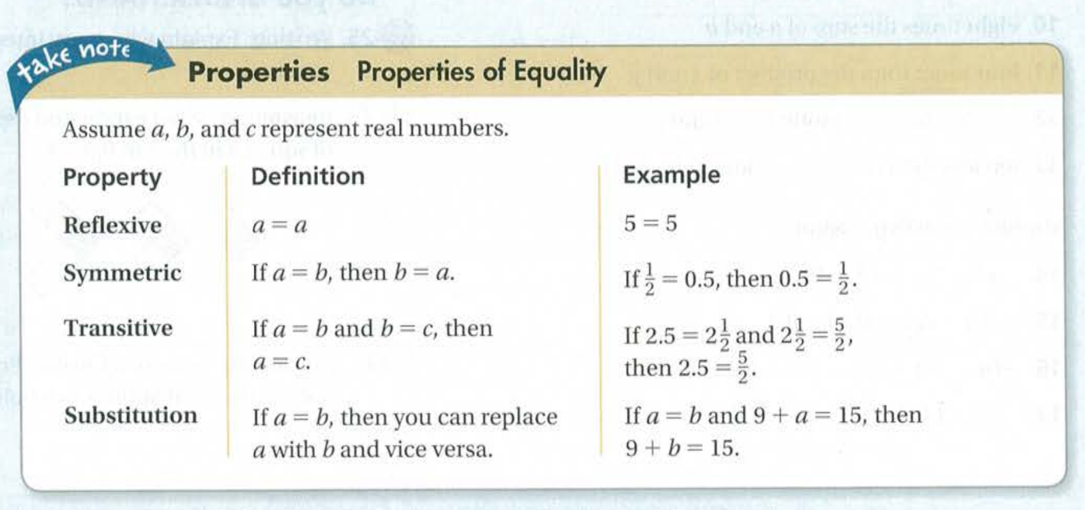
Properties of Equality
Reflexive (自反性):
Symmetric (对称性):
Transitive (传递性):
Substitution (代入):

Slide 20
Exit card:
Finish all three learning sheets:
Algebraic Expression
Real Numbers
Solving Equations

Slide 21
Advance organizer
Learning objectives:
Understand 1.5 Solving Inequalities
Understand 1.6 Absolute Value Equation and Inequalities
Prior knowledge:
Understand 1.3 Algebraic Expressions
Understand 1.4 Solving Equations
Successful criteria:
Controlled Practice: Complete the Exit Card
Freer Practice: Complete questions to your interest
Learning activities:
1. Preview and Vocabulary Check (10 minutes):
Quickly scan through the text and noting any unfamiliar terms.
2. Comprehend the Presentation (45 minutes):
3. Exit Card Completion (25 minutes):
4. Main Idea Summary and Reflection (5 minute):

Slide 22
Key term
Compound Inequality (复合不等式): A mathematical statement that combines two or more inequalities using the logical connectives "and" or "or." It describes a range of values that satisfy multiple conditions.
Absolute Value (绝对值): The distance between a number and zero on the number line. It is denoted by vertical bars (|x|) and represents the magnitude or non-negative value of a real number.
Extraneous Solution (多余解): In the context of solving equations or inequalities, an extraneous solution is a value that appears to satisfy the equation or inequality but, when plugged back into the original expression, does not actually satisfy it.

Slide 23
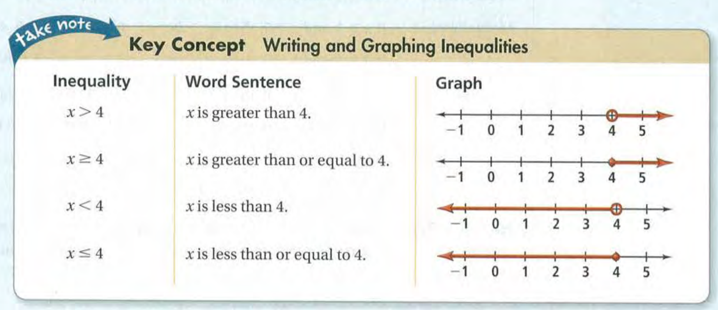

Slide 24
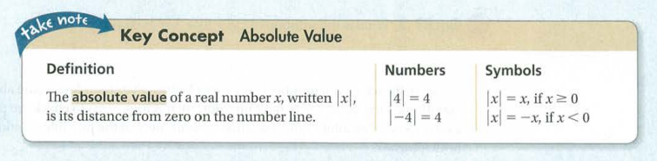

Slide 25
Exit card:
Complete the following learning sheets:
Solving equations
Solving inequalities
Absolute value

Slide 26
Advance organizer
Learning objectives:
Understand 2.1 Relations and Functions
Understand 2.2 Direct Variation
Prior knowledge:
Understand 1.5 Solving Inequalities
Understand 1.6 Absolute Value Equation and Inequalities
Successful criteria:
Controlled Practice: Complete the Exit Card
Freer Practice: Complete questions to your interest
Learning activities:
1. Preview and Vocabulary Check (10 minutes):
Quickly scan through the text and noting any unfamiliar terms.
2. Comprehend the Presentation (45 minutes):
3. Exit Card Completion (25 minutes):
4. Main Idea Summary and Reflection (5 minute):

Slide 27
Key terms
Relation(关系): A set of ordered pairs that relate elements from one set to another set.
Domain(域): The set of all possible input values (independent variables) in a relation or function.
Range(值域): The set of all possible output values (dependent variables) in a relation or function.
Function(函数): A relation in which each input (independent variable) is associated with exactly one output (dependent variable).
Vertical-Line Test(垂直线检验): A graphical test used to determine whether a given relation represents a function. It involves checking if any vertical line intersects the graph at more than one point.
Function Rule(函数规则): An expression or set of instructions that defines how the input values are related to the output values in a function.
Function Notation(函数符号): A symbolic representation used to denote a function, typically written as "f(x)" or "g(x)," where "x" represents the input variable.
Independent Variable(自变量): The variable in a function that is chosen or manipulated by the experimenter. It is the input variable that affects the output.
Dependent Variable(因变量): The variable in a function that is influenced or determined by the independent variable. It is the output variable that depends on the input.

Slide 28
Definition of a function
To be a function a mapping must be many to one or one to one.
So every input value, x, must result in only one output value, y.
Picture this:
One-to-one
function?
Yes!
Many-to-one
function?
Yes!
One-to-many
function?
No!

Slide 29
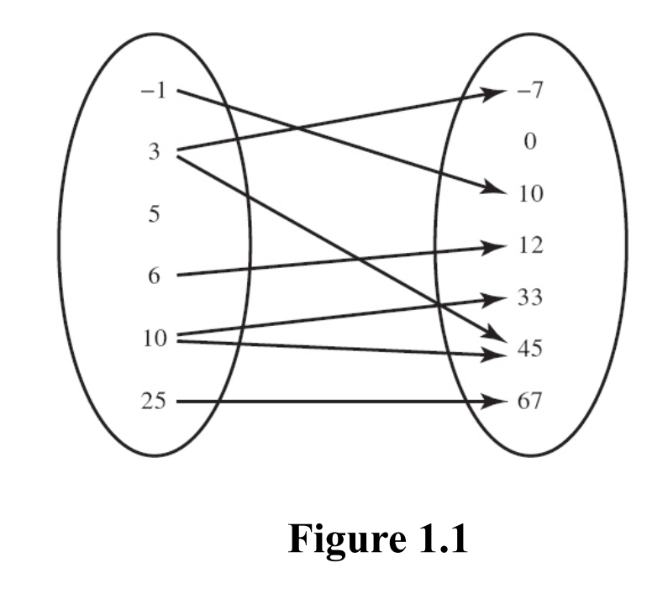
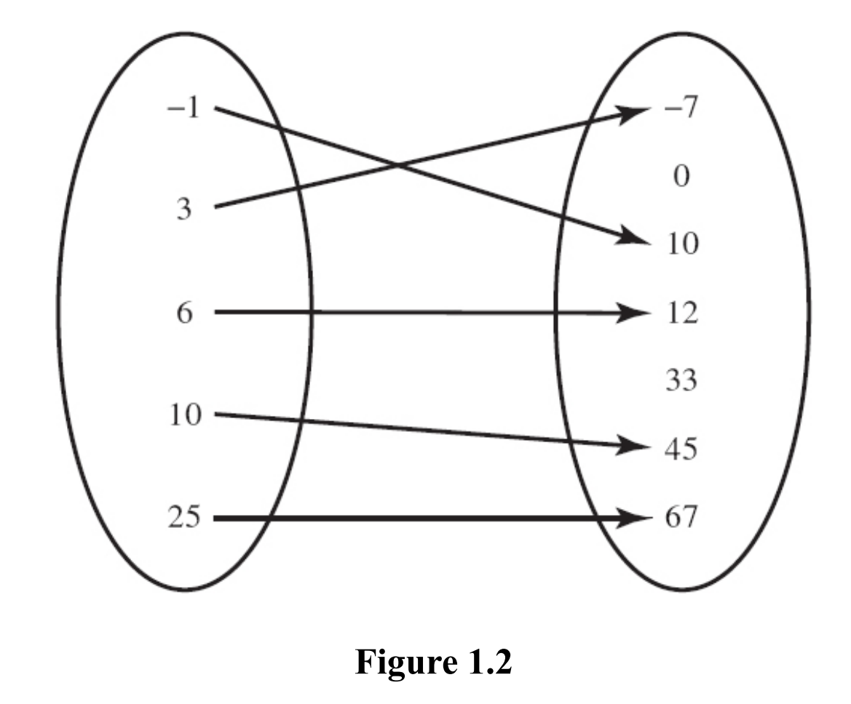
Relations vs. Functions

Slide 30
Vertical line test
What is it used for?
To test a mapping to find out if it is a function.
How?
To be a function a mapping must be
many-to-one or one-to-one.
So every input value, x, must result in
only one output value, y.
As a vertical line sweeps across the
graph, it must touch exactly one point
only.
This mapping is a function.
The graph passes
the vertical line test.
f(x)
x
1

Slide 31
Vertical line test
What is it used for?
To test a mapping to find out if it is a function:
How?
To be a function a mapping must be
many-to-one or one-to-one.
So every input value, x, must result in
only one output value, y.
As a vertical line sweeps across the
graph, it must touch exactly one point
only.
This mapping a function.
The graph passes
the vertical line test.
f(x)
x

Slide 32
Vertical line test
What is it used for?
To test a mapping to find out if it is a function:
How?
To be a function a mapping must be
many-to-one or one-to-one.
So every input value, x, must result in
only one output value, y.
As a vertical line sweeps across the
graph, it must touch exactly one point
only.
This mapping is not a function.
The graph fails
the vertical line test.
f(x)
x
2

Slide 33
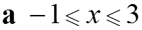
Domain and range
Worked Example 1
1
a Write down the domain of the function f.
b Sketch the graph
of the function f.
Answers

Slide 34
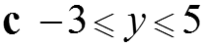
Domain and range
Worked Example 1
a Write down the domain of the function f.
b Sketch the graph
of the function f.
Answers
f(x)
b
5
3
−1
−1
3
x
−3

Slide 35
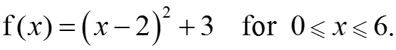
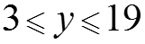
Domain and range
Worked Example 2
1
Find the range of f.
Answers
f(x)
19
2
7
3
2
6
x

Slide 36
Key term:
Direct variation(直接变化): Direct variation refers to a mathematical relationship between two variables in which one variable increases (or decreases) in direct proportion to the other.
Constant of variation(变化常数): The constant of variation, often denoted as "k," is a numerical value that represents the rate of change or the proportionality factor in a direct variation equation. It indicates how much one variable changes in relation to changes in the other variable in a direct variation.

Slide 37
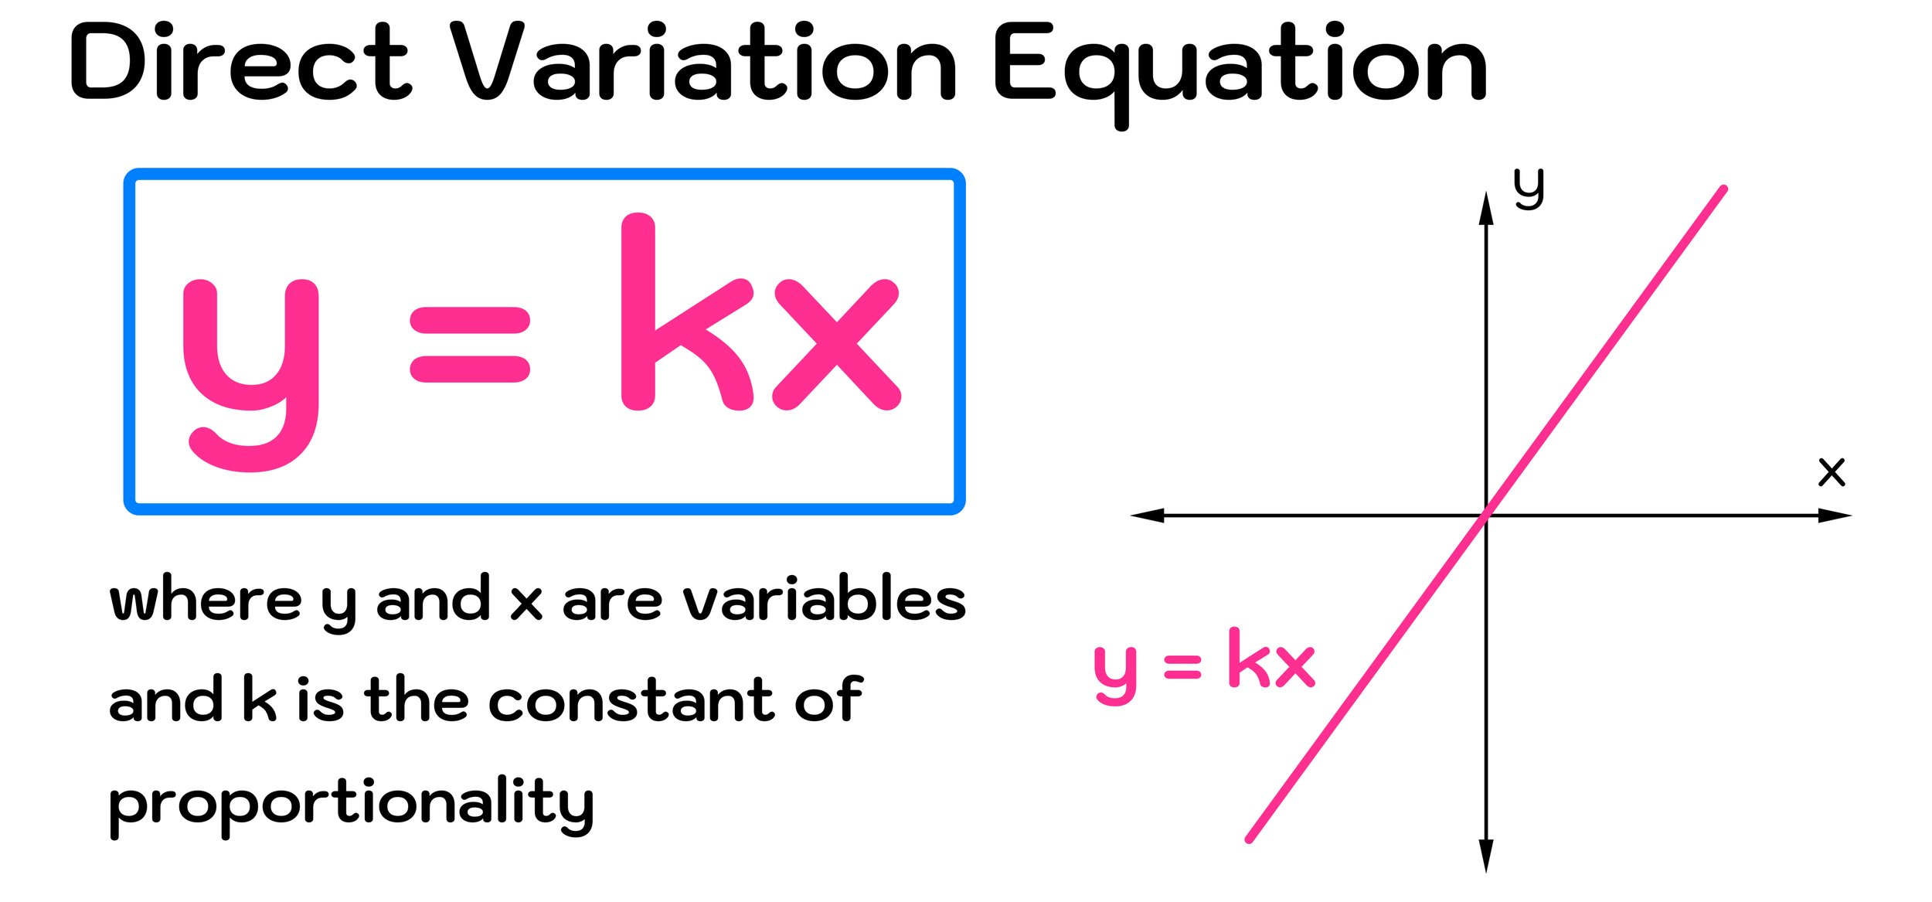

Slide 38
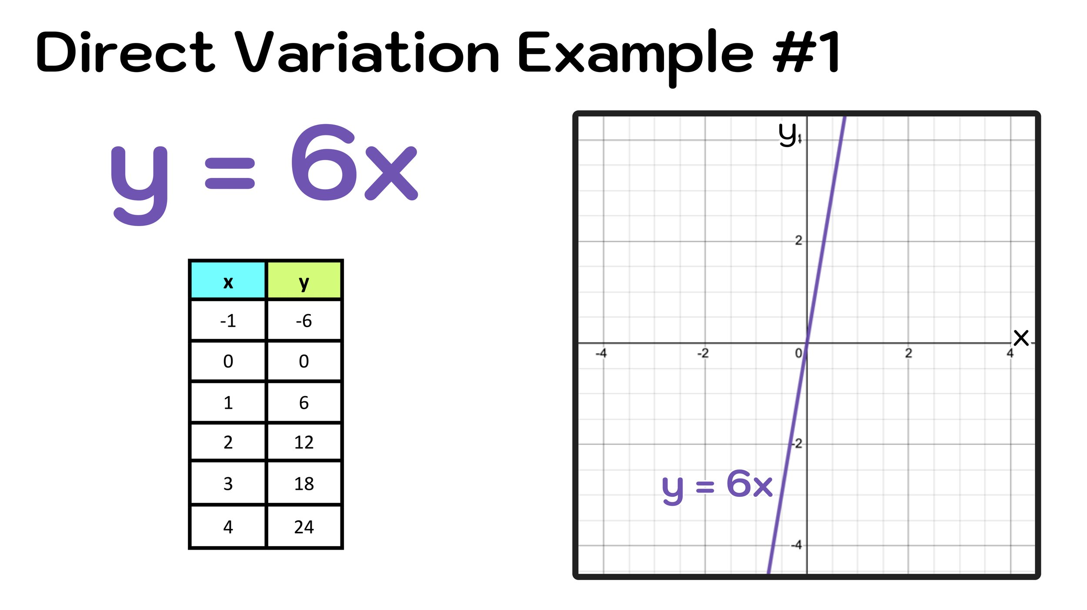

Slide 39
Exit Card:
Relations and Functions learning sheet.
Direct variation learning sheet.

Slide 40





Prepare for your class!
Textbook? Calculator?
Stationary? Toilet?
Notebook?

Slide 41
Advance organizer
Learning objectives:
Understand 2.3 Linear Functions and Slope-Intercept Form
Understand 2.4 More About Linear Equations
Prior knowledge:
Understand 2.1 Relations and Functions
Understand 2.2 Direct Variation
Successful criteria:
Controlled Practice: Complete the Exit Card
Freer Practice: Complete questions to your interest
Learning activities:
1. Preview and Vocabulary Check (10 minutes):
Quickly scan through the text and noting any unfamiliar terms.
2. Comprehend the Presentation (45 minutes):
3. Exit Card Completion (25 minutes):
4. Main Idea Summary and Reflection (5 minute):

Slide 42
Key terms:
Slope (斜率): The steepness or incline of a line on a graph, representing the rate of change between two variables. It is typically denoted by the letter "m" in linear equations like y = mx + b.
Linear equation (线性方程): An equation that describes a linear relationship between variables. It can be written in the form of y = mx + b, where "m" is the slope and "b" is the y-intercept.
Y-intercept (纵轴截距): The point at which a line intersects the vertical or y-axis on a graph. In the linear equation y = mx + b, "b" represents the y-intercept.
X-intercept (横轴截距): The point at which a line intersects the horizontal or x-axis on a graph. It is the value of x when y = 0.
Slope-intercept form (斜率截距式): A specific form of a linear equation, written as y = mx + b, where "m" is the slope of the line, and "b" is the y-intercept. This form is convenient for graphing linear functions.

Slide 43
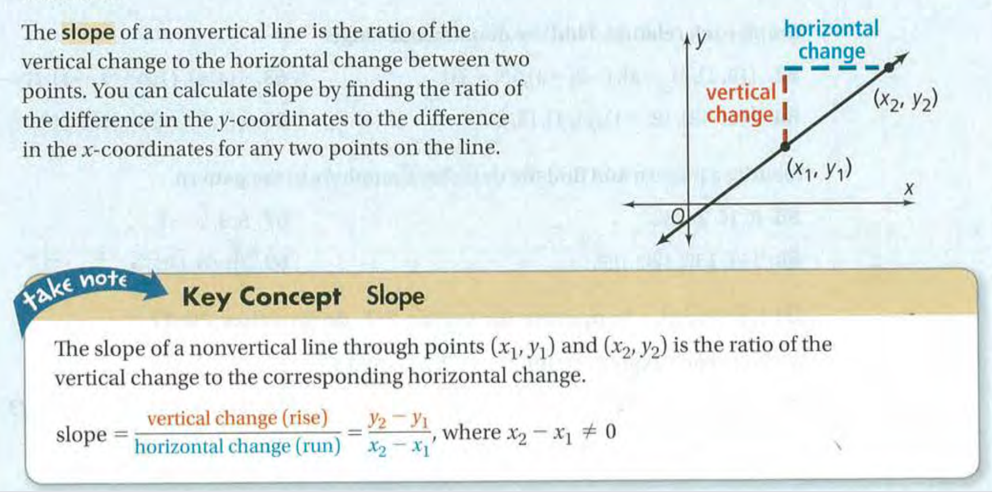

Slide 45
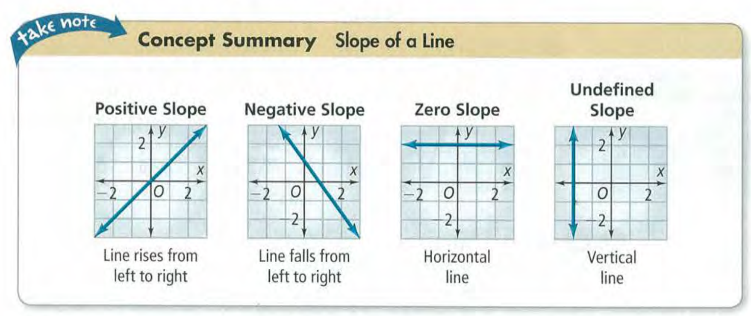

Slide 46
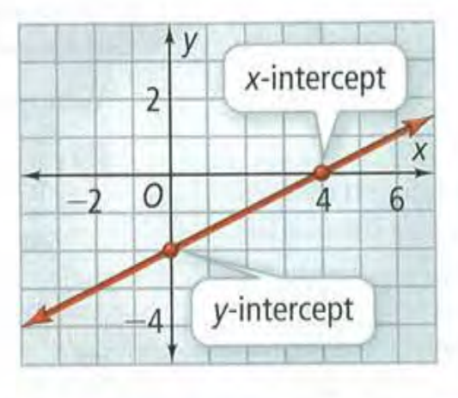
Intercepts

Slide 47


Slide 48
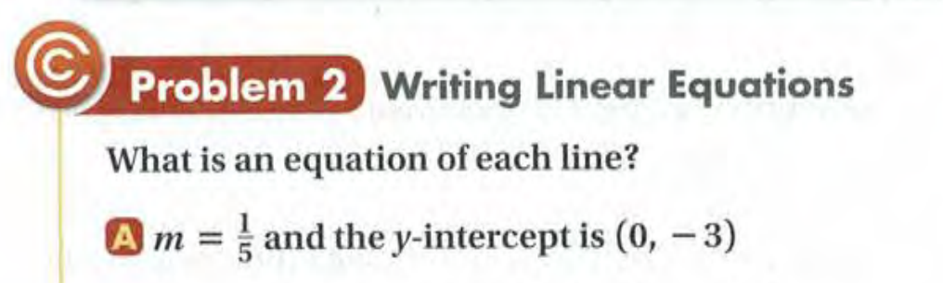

Slide 49
Key terms
Point-slope form (点斜式): A form of a linear equation used to represent a straight line on a graph. It is written in the form of y - y₁ = m(x - x₁), where (x₁, y₁) is a specific point on the line, and "m" is the slope of the line.
Standard form (标准式): A standard way of writing a linear equation in two variables (x and y). In the context of linear equations, it typically refers to an equation in the form Ax + By = C.
Parallel (平行): Describes two or more lines, segments, or objects that are equidistant from each other and never intersect. In geometry, parallel lines have the same slope and will not converge or diverge.
Perpendicular (垂直): Describes a relationship between two lines or segments that meet at a right angle (90 degrees). In geometry, perpendicular lines have slopes that are negative reciprocals of each other, and when they intersect, they form right angles.

Slide 50
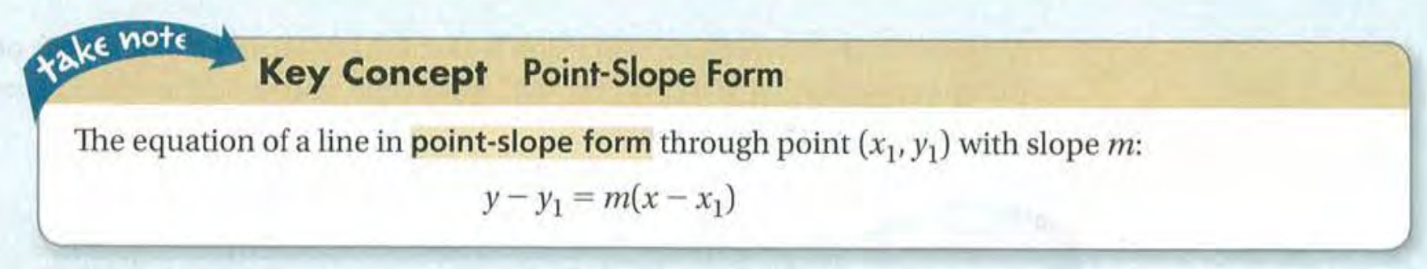

Slide 51
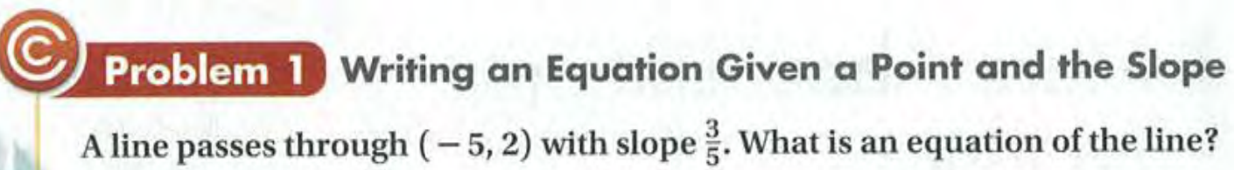

Slide 52
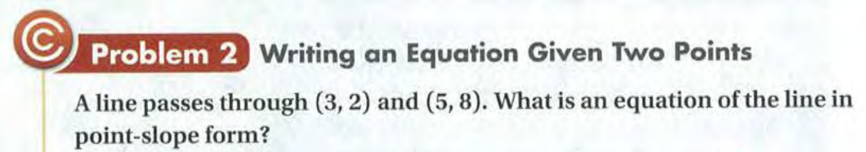

Slide 53
Exit Card: Learning sheets
Linear Functions and Slope-Intercept Form
More About Linear Equations

Slide 54
Advance organizer
Learning objectives:
Understand Piecewise Functions
Prior knowledge:
Understand 2.3 Linear Functions and Slope-Intercept Form
Understand 2.4 More About Linear Equations
Successful criteria:
Controlled Practice: Complete the Exit Card
Freer Practice: Complete questions to your interest
Learning activities:
1. Preview and Vocabulary Check (10 minutes):
Quickly scan through the text and noting any unfamiliar terms.
2. Comprehend the Presentation (45 minutes):
3. Exit Card Completion (25 minutes):
4. Main Idea Summary and Reflection (5 minute):

Slide 55
Key terms:
Piecewise function(分段函数): A function that is defined by different expressions or rules for different intervals or "pieces" of its domain.
Step function(阶梯函数): A function that has a constant value over intervals and "jumps" to a new value at certain points in its domain.
Greatest integer function(最大整数函数): A function, often denoted as [x] or floor(x), that returns the largest integer less than or equal to the given real number x.

Slide 56
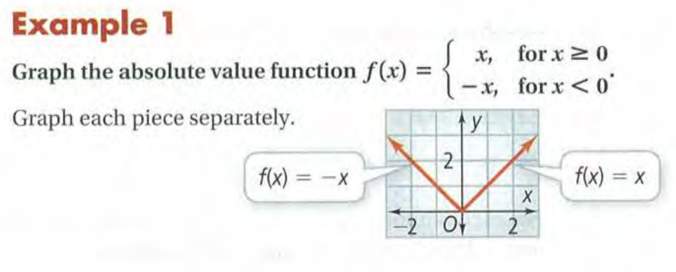

Slide 57
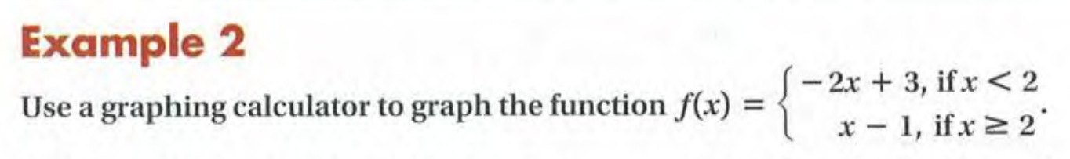

Slide 58
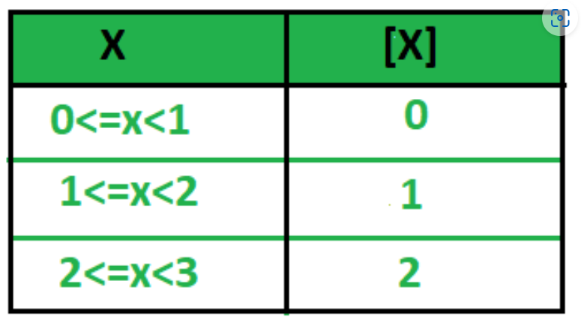
The Greatest Integer Function [X]
The greatest Integer Function [X] indicates an integral part of the real number x which is the nearest and smaller integer to x. It is also known as the floor of X.

Slide 59
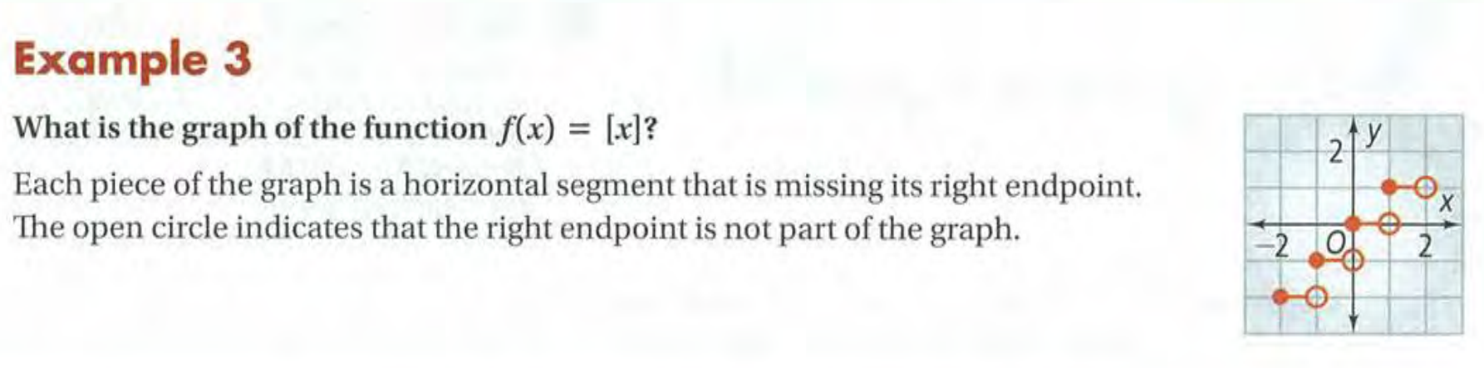

Slide 60
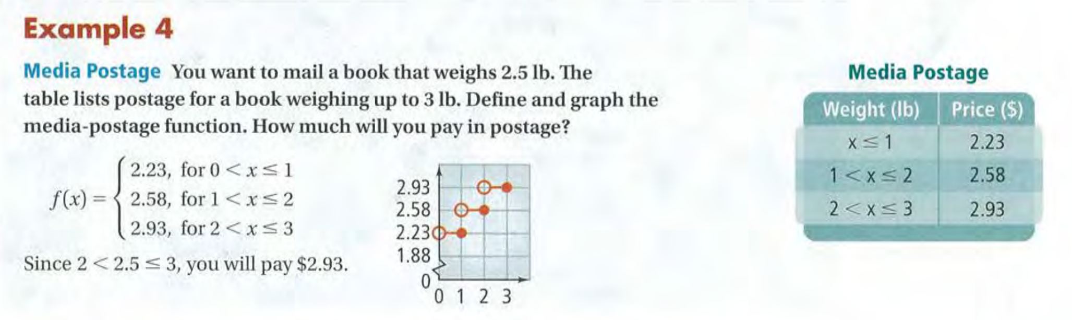

Slide 61
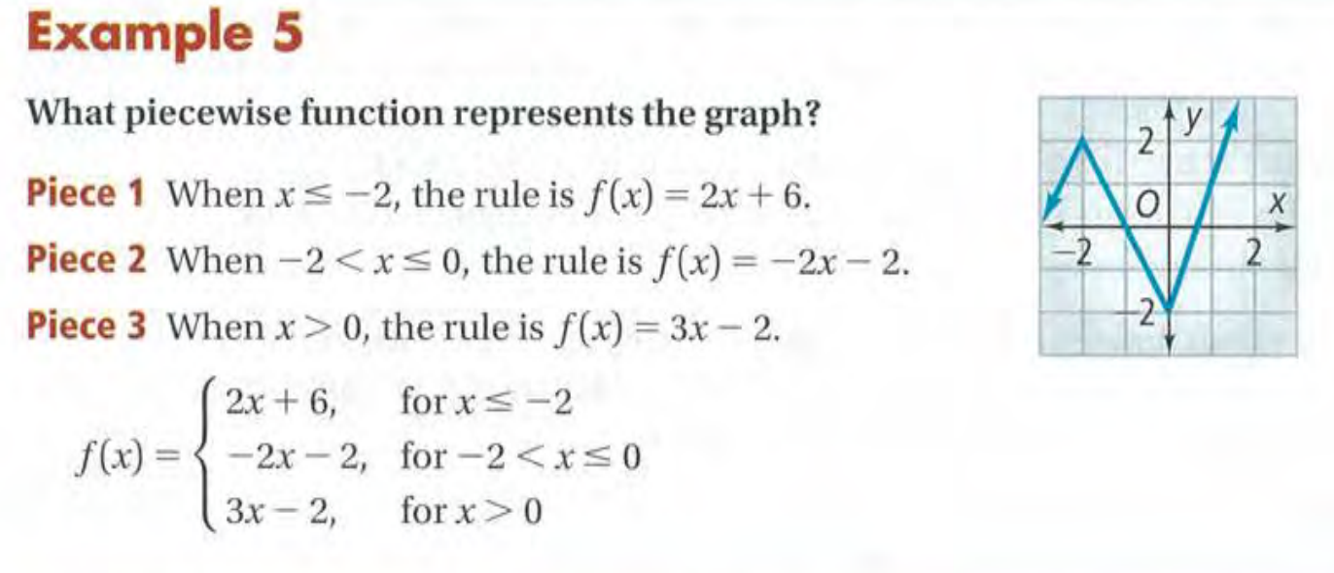

Slide 62
Exit Card:
Complete the Piecewise Functions learning sheet!

Slide 63
Prepare for your class!
Textbook? Calculator?
Stationary? Toilet?
Notebook?

Slide 64
Advance organizer
Learning objectives:
Understand 2.6 Families of Functions
Prior knowledge:
Understand Piecewise Functions
Successful criteria:
Controlled Practice: Complete the Exit Card
Freer Practice: Complete questions to your interest
Learning activities:
1. Preview and Vocabulary Check (10 minutes):
Quickly scan through the text and noting any unfamiliar terms.
2. Comprehend the Presentation (45 minutes):
3. Exit Card Completion (25 minutes):
4. Main Idea Summary and Reflection (5 minute):

Slide 65
Key terms:
Parent function (母函数): The basic function in a family of functions, often used as a reference or starting point for transformations.
Transformation (变换): A change applied to a function that alters its shape, position, or other properties.
Reflection (反射): A transformation that flips a function over a line, such as the x-axis or y-axis, creating a mirrored image.
Vertical stretch (垂直伸缩): A transformation that elongates a function vertically, making it taller.
Vertical compression (垂直压缩): A transformation that shrinks a function vertically, making it shorter.

Slide 66
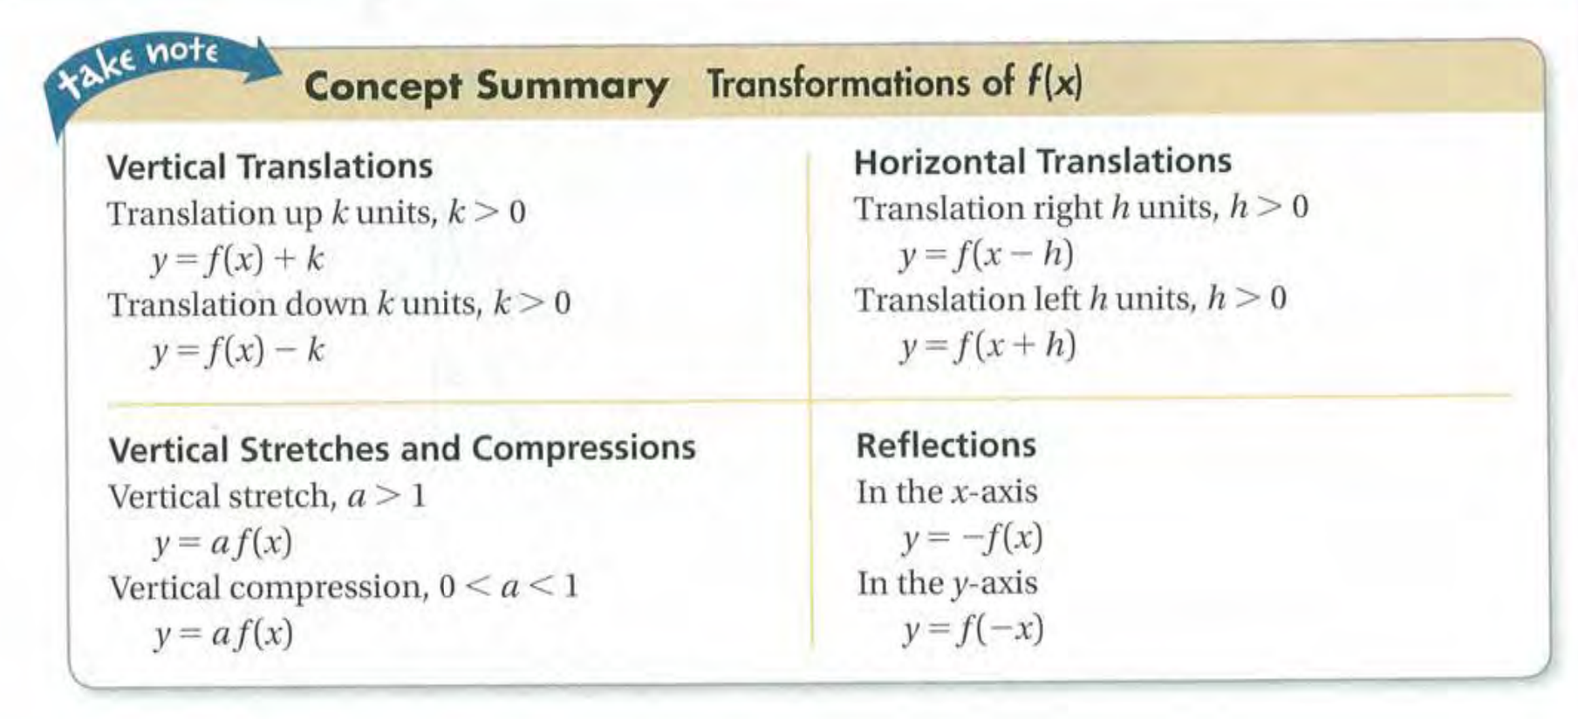

Slide 67
Exit Card: Learning sheets
Families of Functions

Slide 68
Advance organizer
Learning objectives:
Understand 2.5 Using Linear Models
Prior knowledge:
Understand Piecewise Functions
Successful criteria:
Controlled Practice: Complete the Exit Card
Freer Practice: Complete questions to your interest
Learning activities:
1. Preview and Vocabulary Check (10 minutes):
Quickly scan through the text and noting any unfamiliar terms.
2. Comprehend the Presentation (45 minutes):
3. Exit Card Completion (25 minutes):
4. Main Idea Summary and Reflection (5 minute):

Slide 69
Key terms:
Scatter plot(散点图): A scatter plot is a graphical representation of data points in a two-dimensional space, where each point represents the values of two variables.
Correlation(相关性 ): Correlation refers to the statistical measure that quantifies the extent to which two variables are related or associated.
Line of best fit(最佳拟合线): The line of best fit is a straight line that represents the best approximation of a relationship between two variables in a scatter plot.
Correlation coefficient(相关系数): The correlation coefficient is a statistical measure that quantifies the strength and direction of the linear relationship between two variables in a dataset.

Slide 70
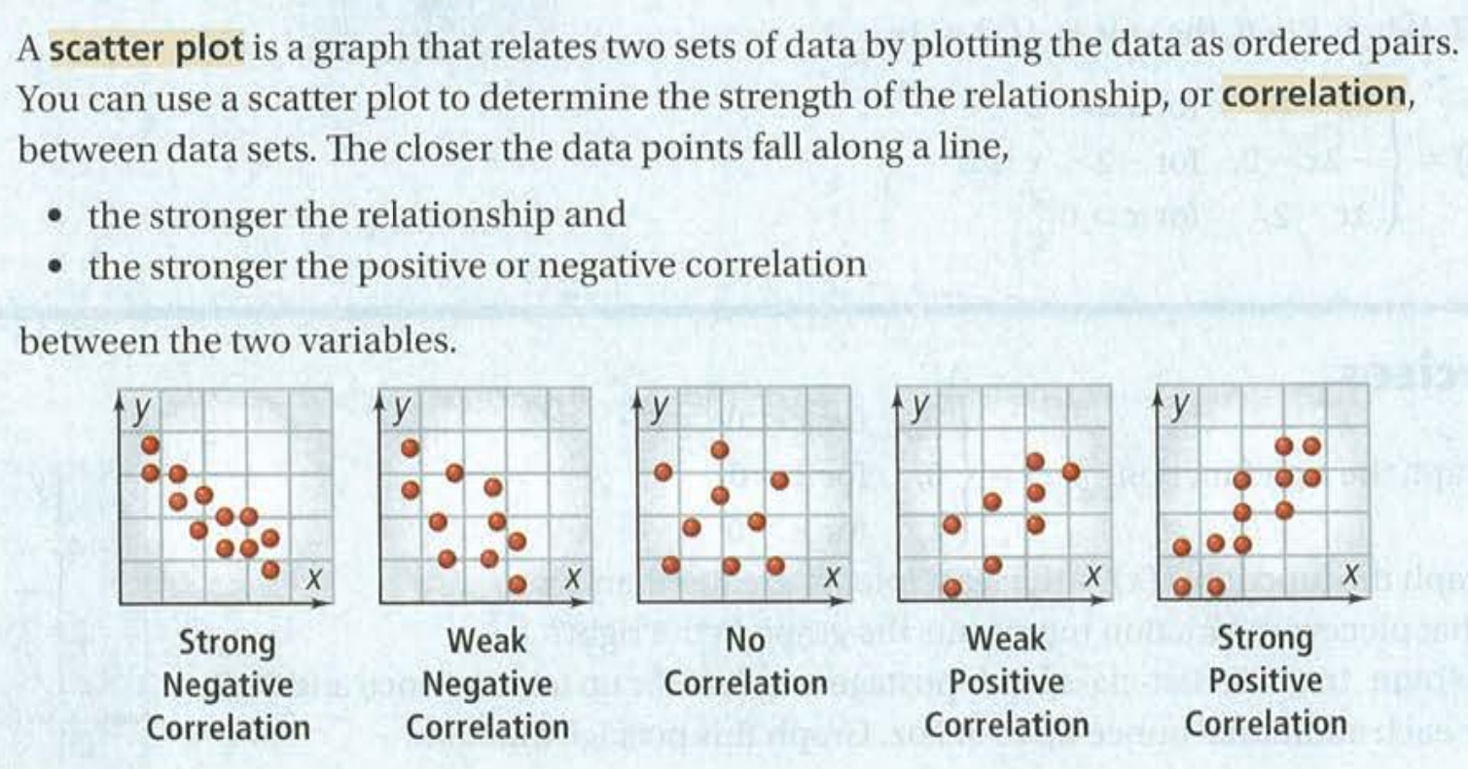

Slide 71
Exit Card: Learning sheets
1. Using Linear Models

Slide 72
Advance organizer
Learning objectives:
Understand 2.7 Absolute Value Functions and Graph
Prior knowledge:
Understand 2.5 Using Linear Models
Successful criteria:
Controlled Practice: Complete the Exit Card
Freer Practice: Complete questions to your interest
Learning activities:
1. Preview and Vocabulary Check (10 minutes):
Quickly scan through the text and noting any unfamiliar terms.
2. Comprehend the Presentation (45 minutes):
3. Exit Card Completion (25 minutes):
4. Main Idea Summary and Reflection (5 minute):

Slide 73
Key terms
Absolute Value Function (绝对值函数): A mathematical function that returns the non-negative value of a real number, disregarding its sign. It is often denoted as |x| and is defined as follows:
|x| = x, if x is greater than or equal to 0.
|x| = -x, if x is less than 0.
Axis of Symmetry (对称轴): In geometry, the axis of symmetry is a line, curve, or imaginary axis that divides a figure or object into two identical or mirror-image halves.
Vertex (顶点): In mathematics, a vertex typically refers to the point at which two or more lines, edges, or curves meet. In the context of a parabolic curve or quadratic function, a vertex is the highest or lowest point on the curve and is also known as the "turning point."

Slide 74
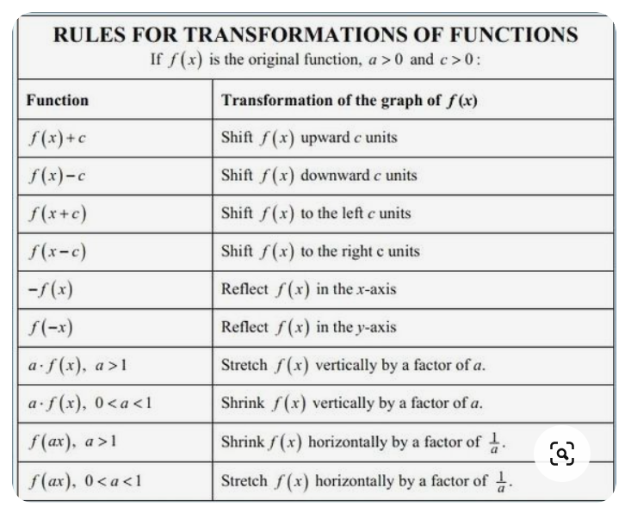
Review on transformation

Slide 75
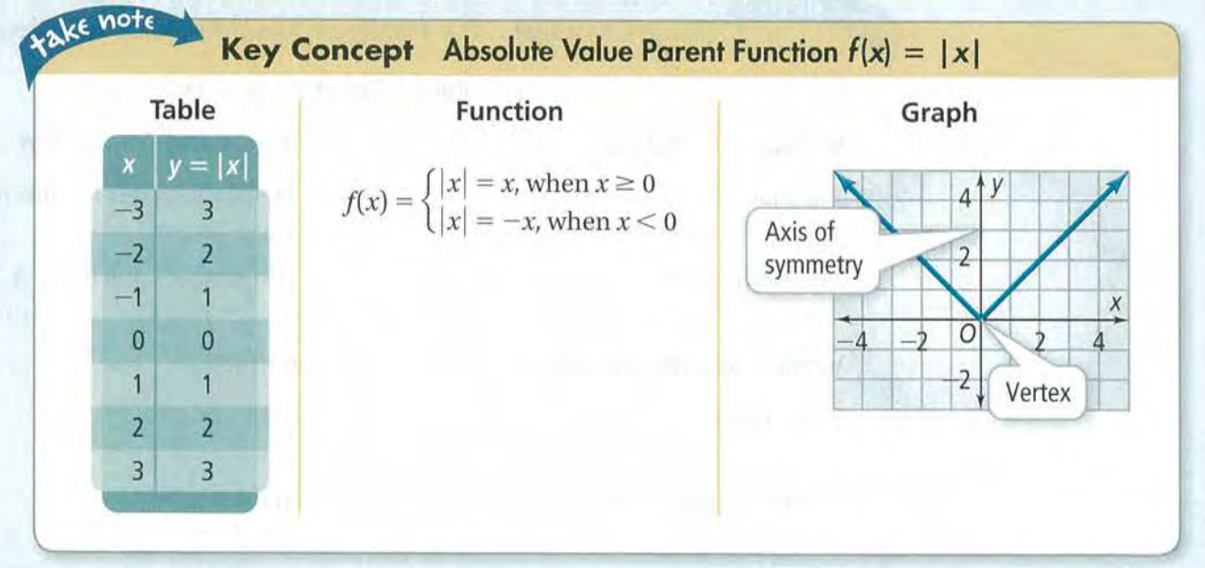

Slide 76
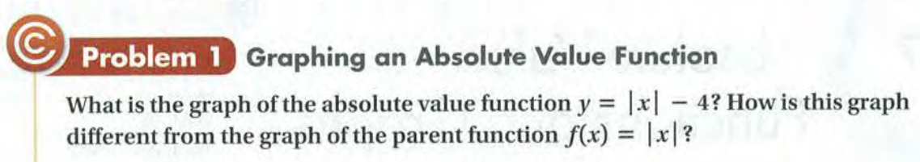
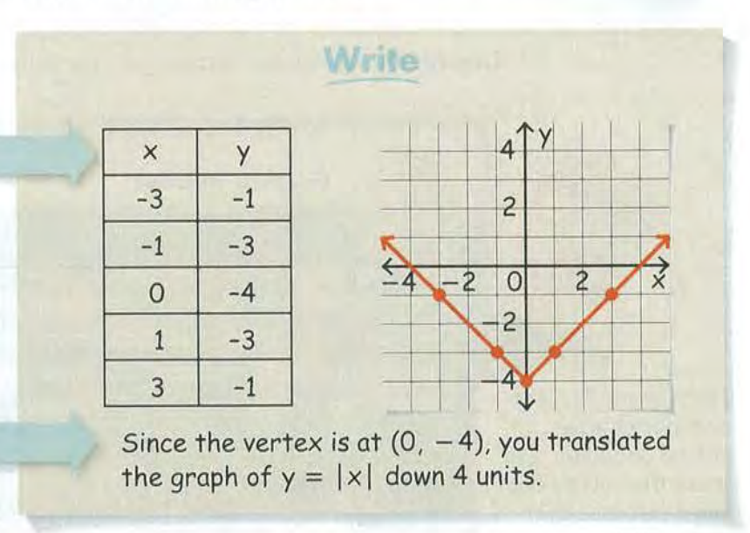

Slide 77
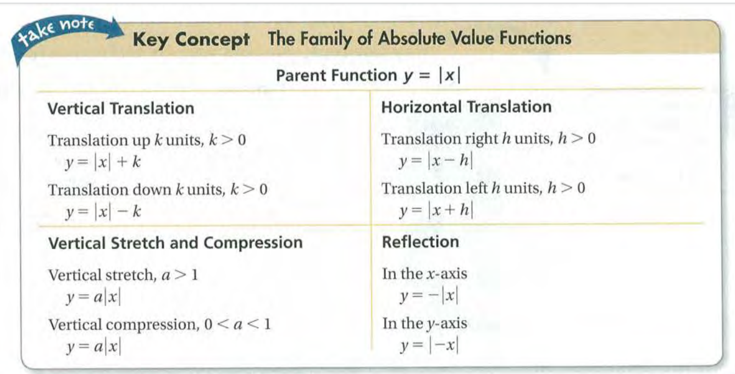

Slide 78
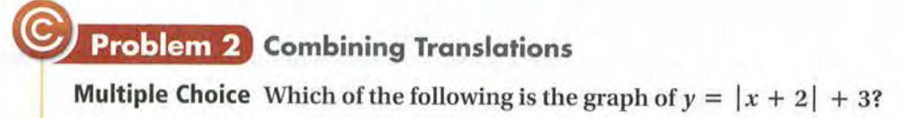
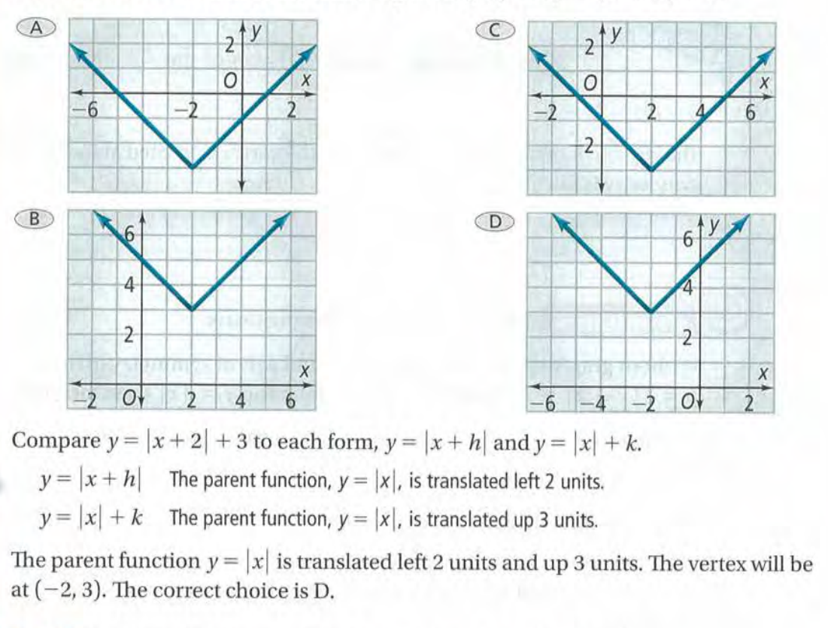

Slide 79
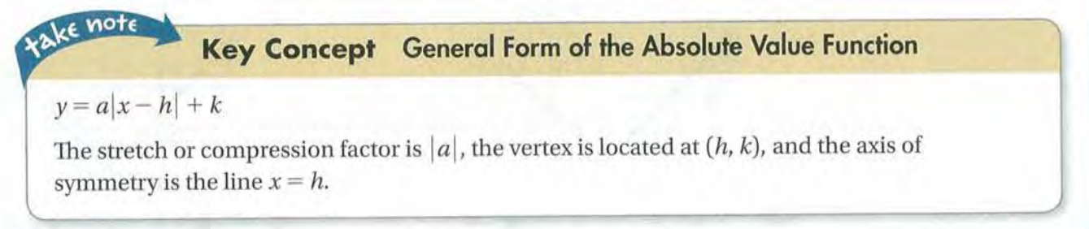

Slide 80
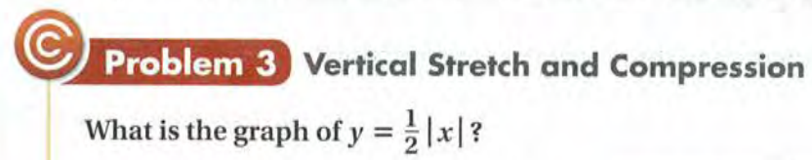
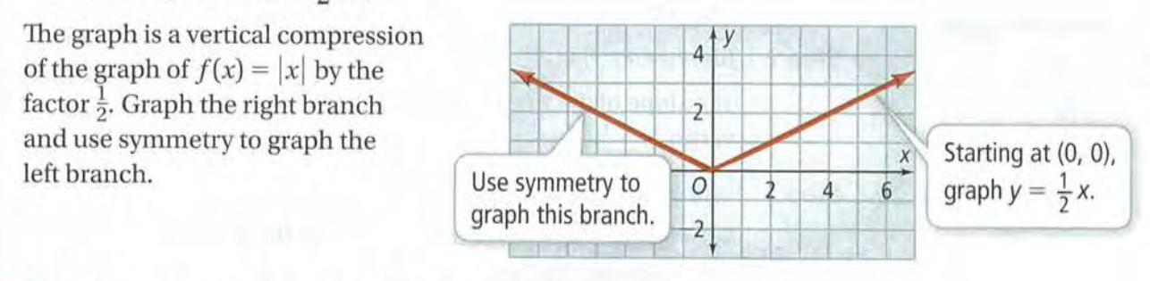

Slide 81
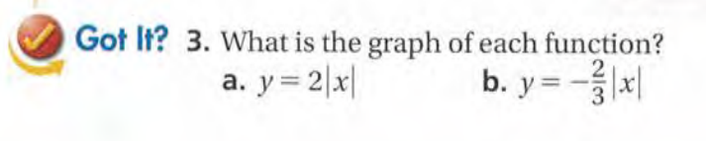

Slide 82
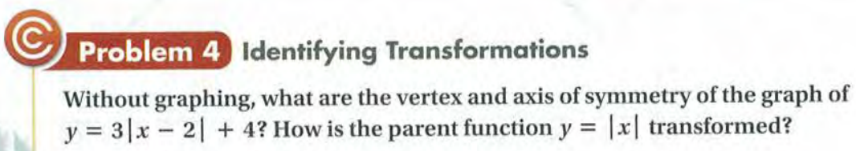

Slide 83
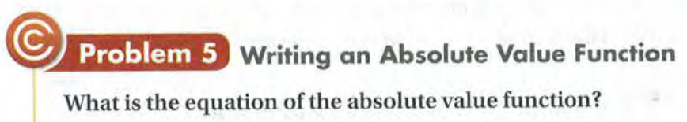
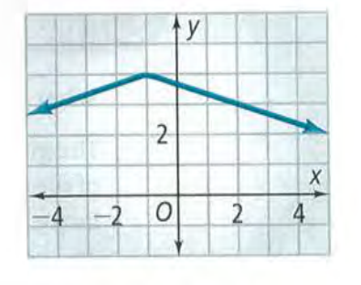
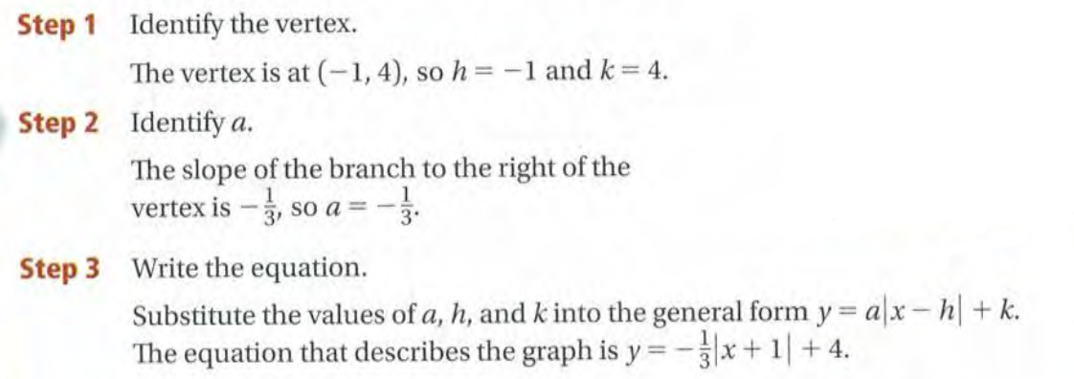

Slide 84
Exit Card:
Absolute Value learning sheet!

Slide 85
Advance organizer
Learning objectives:
Understand 2.8 Two-Variable Inequalities
Prior knowledge:
Understand 2.7 Absolute Value Functions and Graph
Successful criteria:
Controlled Practice: Complete the Exit Card
Freer Practice: Complete questions to your interest
Learning activities:
1. Preview and Vocabulary Check (10 minutes):
Quickly scan through the text and noting any unfamiliar terms.
2. Comprehend the Presentation (45 minutes):
3. Exit Card Completion (25 minutes):
4. Main Idea Summary and Reflection (5 minute):

Slide 86
Key terms:
Linear Inequality (线性不等式): A mathematical statement that compares two algebraic expressions using inequality symbols (e.g., <, >, ≤, or ≥), indicating the relationship between the two sides.
Boundary (边界): The edge or limit of a set or region, often represented as a line or curve in a geometric context, which separates one area from another.
Half-Plane (半平面): In geometry, a half-plane is one of the two regions formed by a boundary line. It can be thought of as one side of a line that extends infinitely in one direction.
Test Point (测试点): A point selected for evaluating the truth or falsity of an inequality or equation. It helps determine which side of a boundary a solution lies in a mathematical context.

Slide 87


Slide 88


Slide 89


Slide 90


Slide 91


Slide 92



Slide 93



Slide 94


Slide 95
Exit Card:
Complete the Two variable inequalities learning sheet!

